Slide 1
Endoscopia pre-operatoria
Roberto Di Mitri
Chief of Gastroenterology and Digestive Endoscopy Unit
Azienda di Rilievo Nazionale ed Alta Specializzazione
" Ospedali " ARNAS Civico Di Cristina Benfratelli
Palermo, Italy

Slide 2
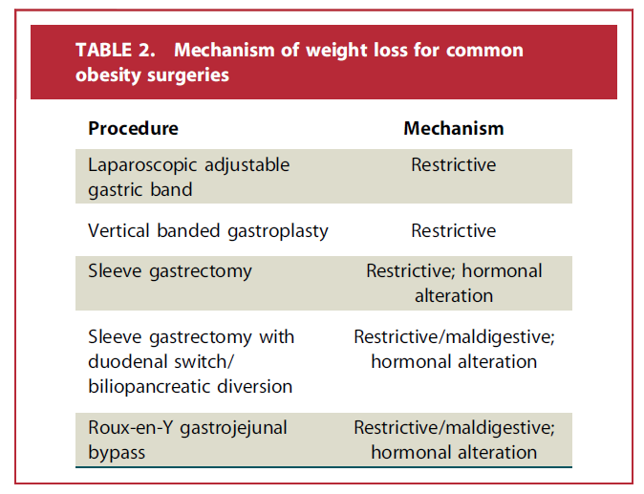
INTRODUCTION
Bariatric procedures have drastically increased in the last decade
Treatment of patients with morbid obesity can be challenging and requires an individualized approach
Routine pre-operative gastroscopy is a controverse topic
Preoperative endoscopy with EGD can identify patients with asymptomatic anatomic findings that may alter surgical planning.
Notes:
Bariatric surgery is the most effective method to obtain a sustained reduction in body weight [4]. The most frequently performed bariatric procedures are laparoscopic sleeve gastrectomy (LSG) and Roux-en-Y gastric bypass (RYGB) [5]

Slide 3
HOW TO DO IT
Pre-diagnostica con inquadramento del paziente
Anamnesi (familiarità, abitudini, fumo)
Sintomi
Noto intervento bariatrico da eseguire? By-pass o LSG o altro?
Notes:
Dire qualcosa sul chirurgo\centro che lo segue, noi siamo un centro di riferimento per cui eseguiamo circa 5000 egds all’anno. Molti pazienti vengono da noi per eseguire EGDS che vengono inviati da diverti specialisti. A volte noi non conosciamo il tipo di intervento che il paziente andrà a fare quindi il nostro esame endoscopico potrebbe essere l’ultima valutazione endoscopica che il nostro paziente farà nella sua vita qualora venga optato un by-pass gastrico quindi potrebbe essere un’esame estremamente importante e complesso.

Slide 4
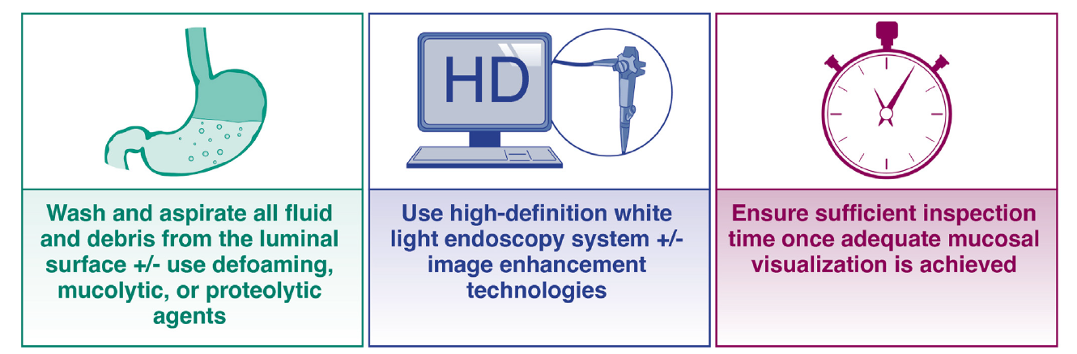
HOW TO DO IT
Diagnostica: EGDS di qualità
Timing schedulato di circa 10-12 minuti
Utilizzo di strumenti ad alta definizione con sistemi di magnificazione virtuale
Corretta sedazione (paziente bariatrico necessita molto spesso di un supporto anestesiologico)
Utilizzo di protocolli e classificazioni standardizzate
Nagula S et al, Clinical Gastroenterology and Hepatology 2024;22:933–943
Notes:
Dire qualcosa sul chirurgo\centro che lo segue, noi siamo un centro di riferimento per cui eseguiamo circa 5000 egds all’anno. Molti pazienti vengono da noi per eseguire EGDS che vengono inviati da diverti specialisti. A volte noi non conosciamo il tipo di intervento che il paziente andrà a fare quindi il nostro esame endoscopico potrebbe essere l’ultima valutazione endoscopica che il nostro paziente farà nella sua vita qualora venga optato un by-pass gastrico quindi potrebbe essere un’esame estremamente importante e complesso.

Slide 5
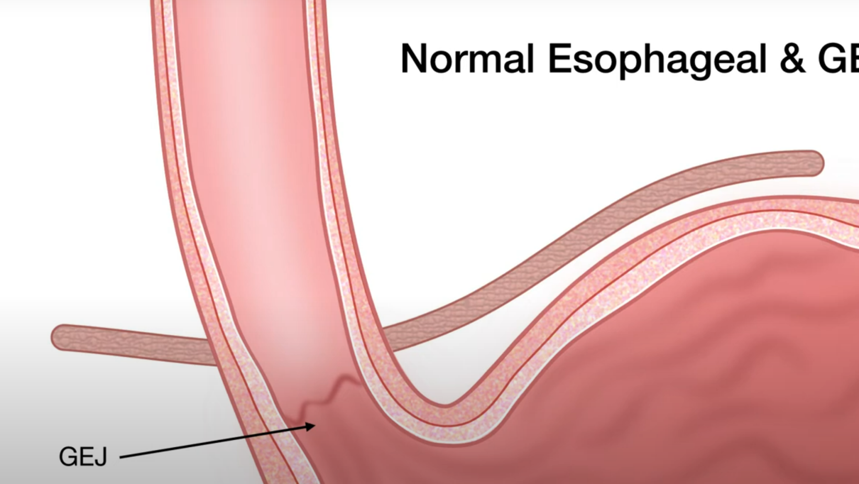
HOW TO DO IT
Esophagus
Integrità della mucosa
Corretta motilità
Giunzione esofago-gastrica
Giunzione squamo-colonnare
Impronta diaframmatica
± biopsie

Slide 6
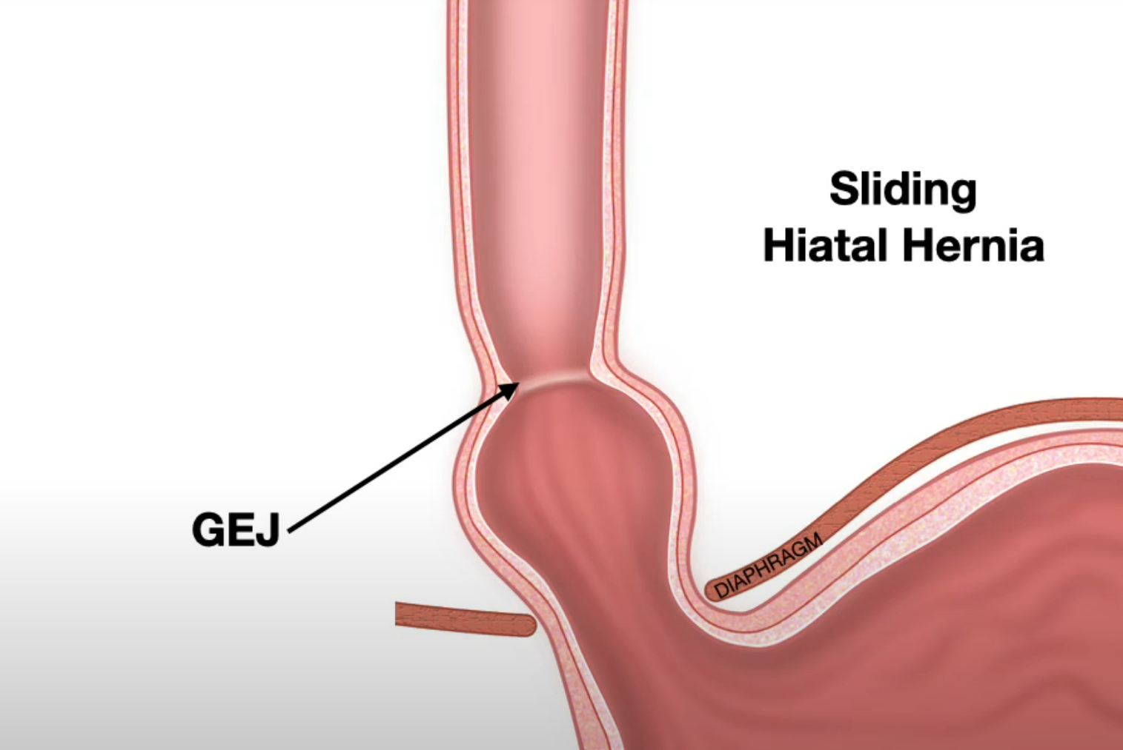
Classificazione Ernia Iatale

Slide 7
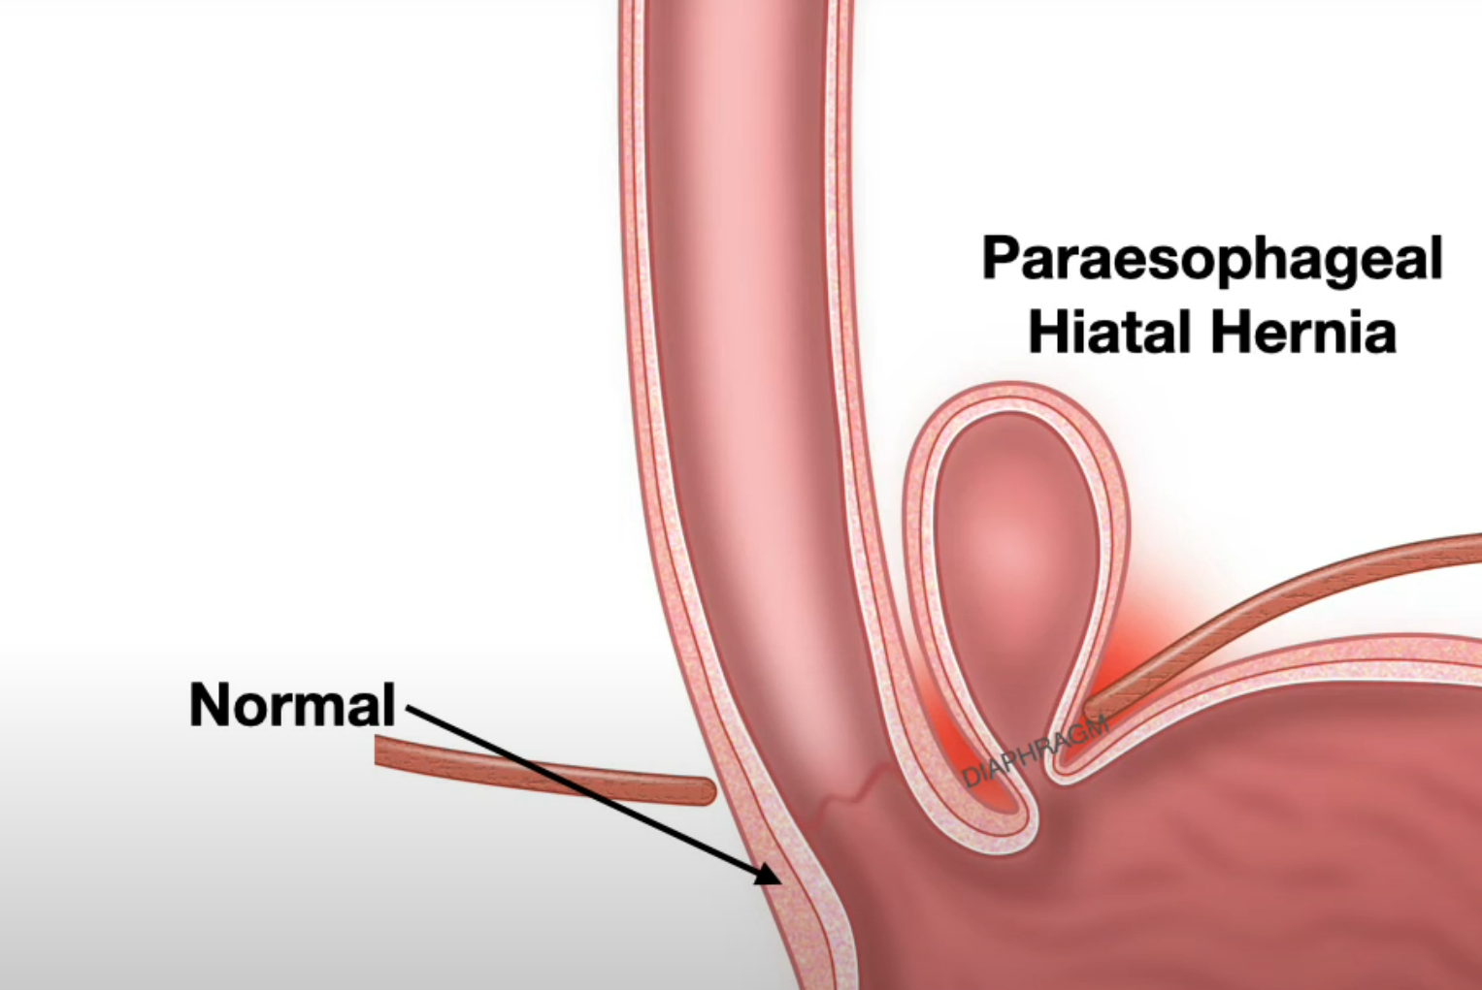
Classificazione Ernia Iatale

Slide 8
Classificazione di Hill
Nagula S et al, Clinical Gastroenterology and Hepatology 2024;22:933–943

Slide 9
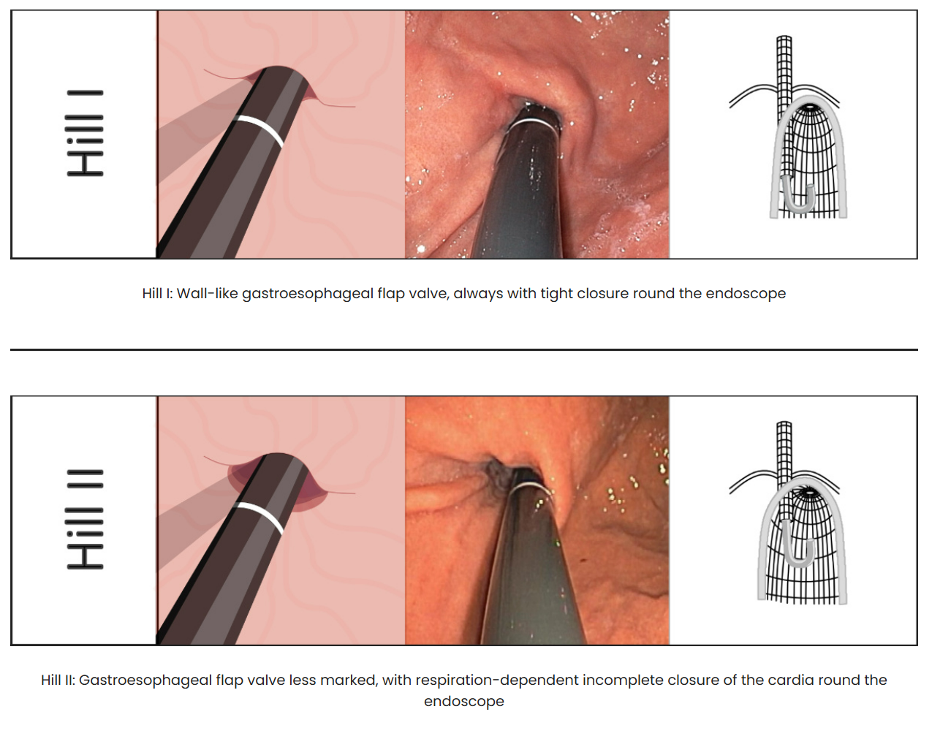
Classificazione di Hill
Menon S et al, Eur J Gastroenterol Hepatol. 2011

Slide 10
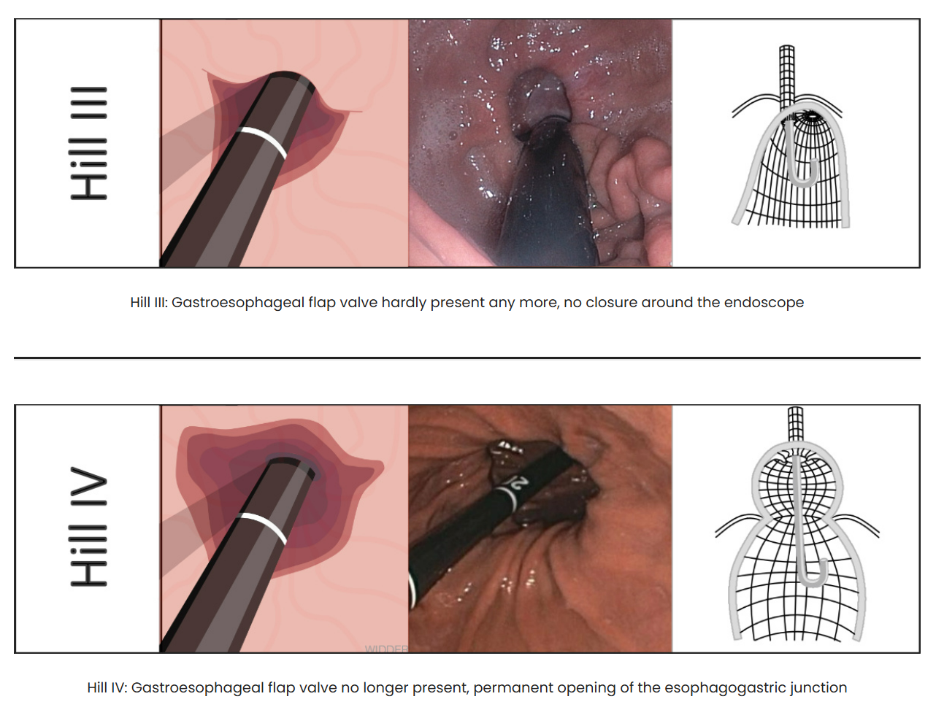
Classificazione di Hill
Menon S et al, Eur J Gastroenterol Hepatol. 2011

Slide 11
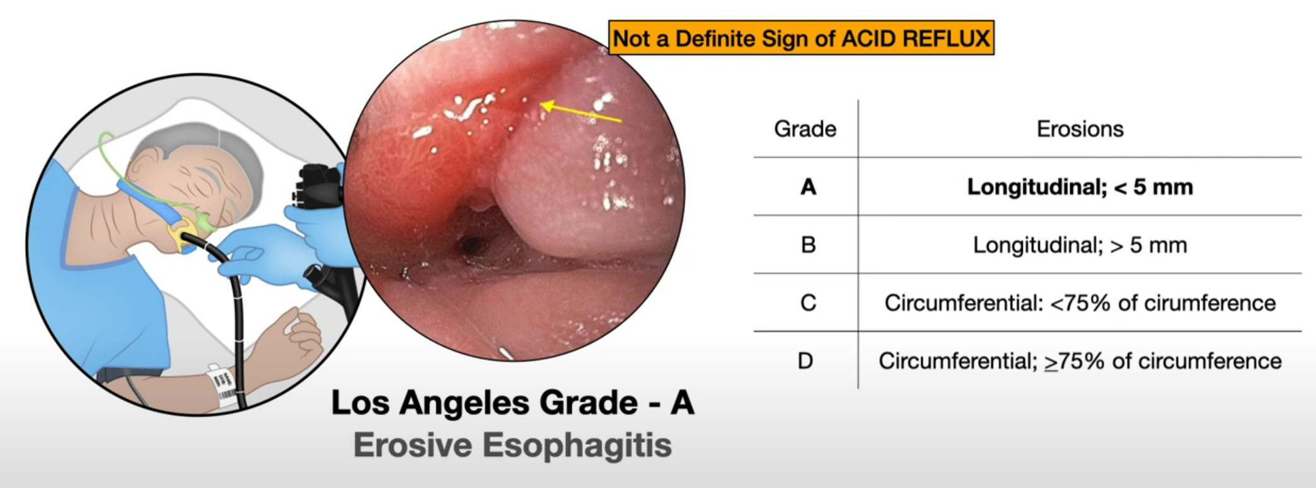
Integrità della mucosa esofagea
Los Angeles classification
Fass R et al, Am J Gastroenterol. 2002

Slide 12
Integrità della mucosa esofagea
Los Angeles classification
Fass R et al, Am J Gastroenterol. 2002

Slide 13
Integrità della mucosa esofagea
Los Angeles classification
Fass R et al, Am J Gastroenterol. 2002

Slide 14
Integrità della mucosa esofagea
Los Angeles classification
Fass R et al, Am J Gastroenterol. 2002

Slide 15
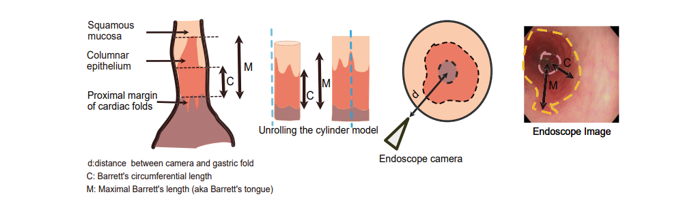
Barrett esophagus
Prague classification
Sharma P et al, Gastroenterology. 2006
Nagula S et al, Clinical Gastroenterology and Hepatology 2024;22:933–943

Slide 16
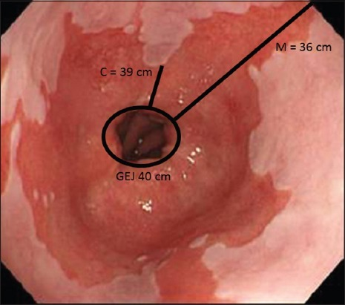
Barrett esophagus
Prague classification
Sharma P et al, Gastroenterology. 2006

Slide 17
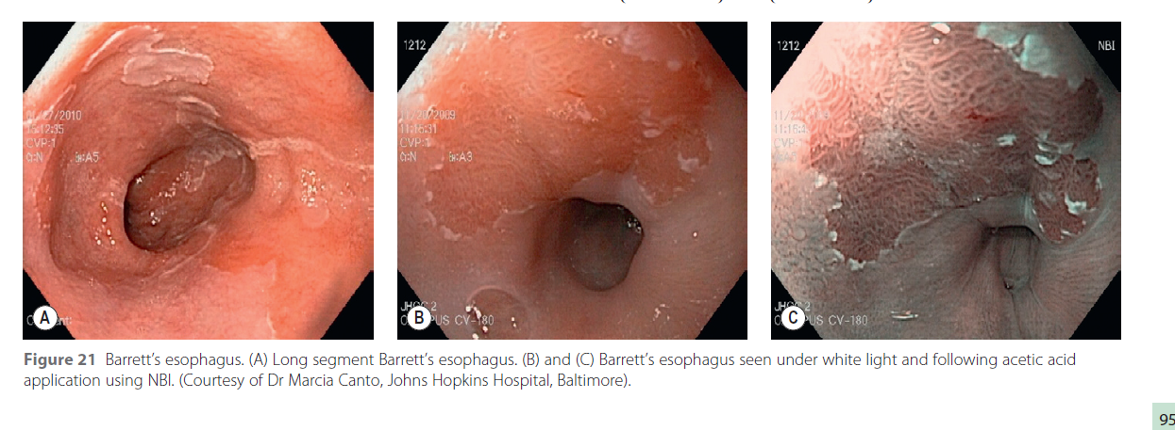
Barrett esophagus
Prague classification
Sharma P et al, Gastroenterology. 2006

Slide 18
Barrett esophagus
Prague classification
Sharma P et al, Gastroenterology. 2006

Slide 19
HOW TO DO IT
Biopsy: Seattle protocol
Nagula S et al, Clinical Gastroenterology and Hepatology 2024;22:933–943

Slide 20
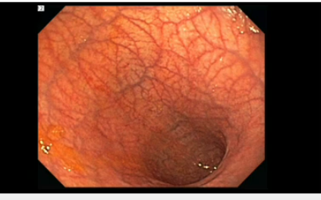
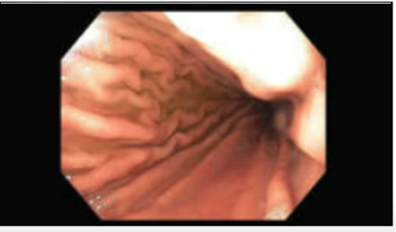
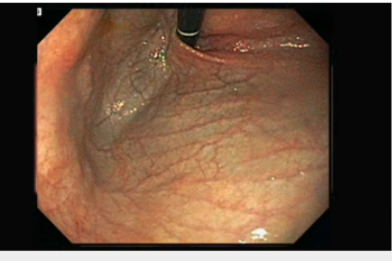
HOW TO DO IT
Stomach
Integrità della mucosa (erosioni? atrofia?)
Morfologia
± biopsie
Gastrointestinal endoscopy in practice, book; 2011
Notes:
Normal, gastrite atrofica con metaplasia

Slide 21
HOW TO DO IT
Stomach
Gastrointestinal endoscopy in practice, book; 2011
Notes:
Gastropatia ipertensiva, erosioni

Slide 22
HOW TO DO IT
Stomach
Gastrointestinal endoscopy in practice, book; 2011
Notes:
Varici, polipi?, ulcere neoplastiche

Slide 23
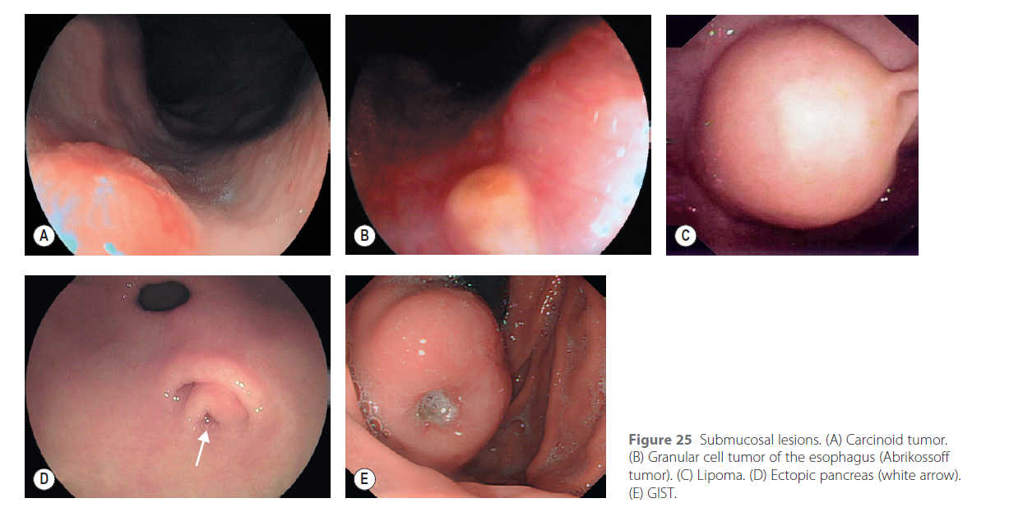
HOW TO DO IT
Stomach
Gastrointestinal endoscopy in practice, book; 2011
Notes:
Lesioni sottoepiteliali

Slide 24
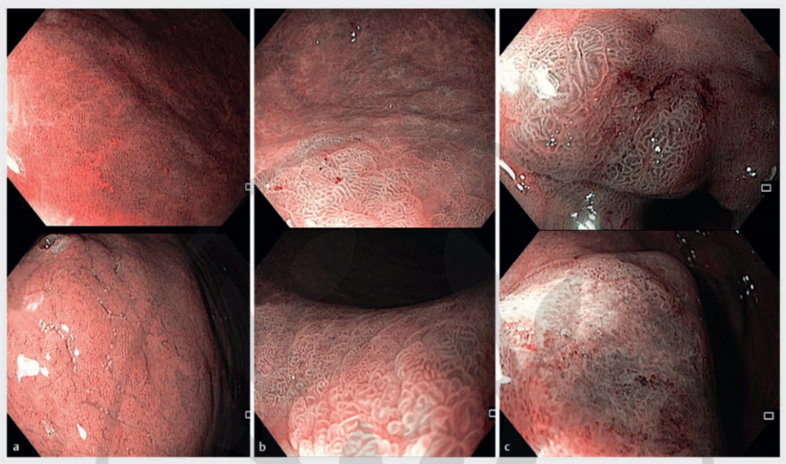
HOW TO DO IT
NBI
Pimentel-Nunes Pedro et al. MAPS II … Endoscopy 2019; 51
Notes:
Simplified narrow-band imaging (NBI) classification for the endoscopic diagnosis of gastric precancerous conditions and lesions. a Antrum (upper panel) and body (lower panel): normal gastric mucosa. A regular and circular/oval mucosal pattern with regular thin/peripheral (body) or thick/central (antrum) vessels is highly predictive of a normal mucosa. b Intestinal metaplasia (IM). Regular vessels with ridge/tubular or tubulovillous glands, particularly with a light blue crest, are highly suggestive of IM. In general, these areas of mucosa alternate with areas of normal but atrophic mucosa. c Dysplasia/carcinoma. Irregular vessels and glands (upper panel, high grade dysplasia lesion), or absent glands with complete architectural loss of the mucosal and vascular pattern (lower panel, intramucosal adenocarcinoma) predict neoplastic changes of the mucosa.

Slide 25
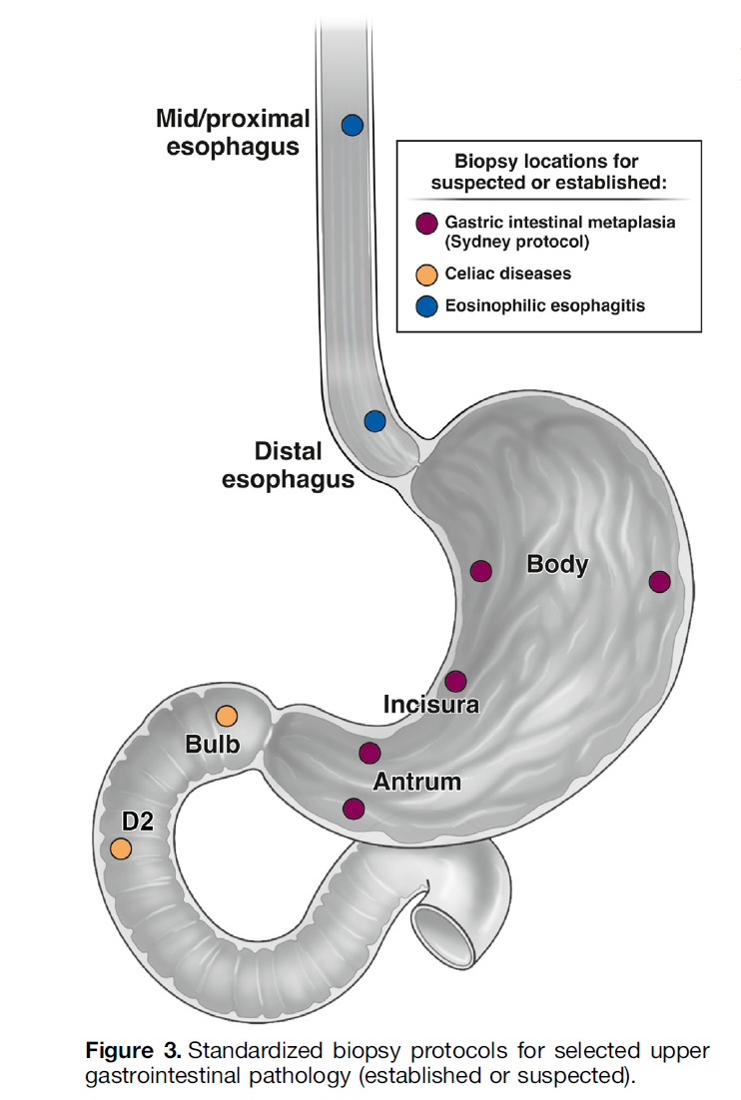
HOW TO DO IT
Biopsy: Sydney protocol
Nagula S et al, Clinical Gastroenterology and Hepatology 2024;22:933–943

Slide 26
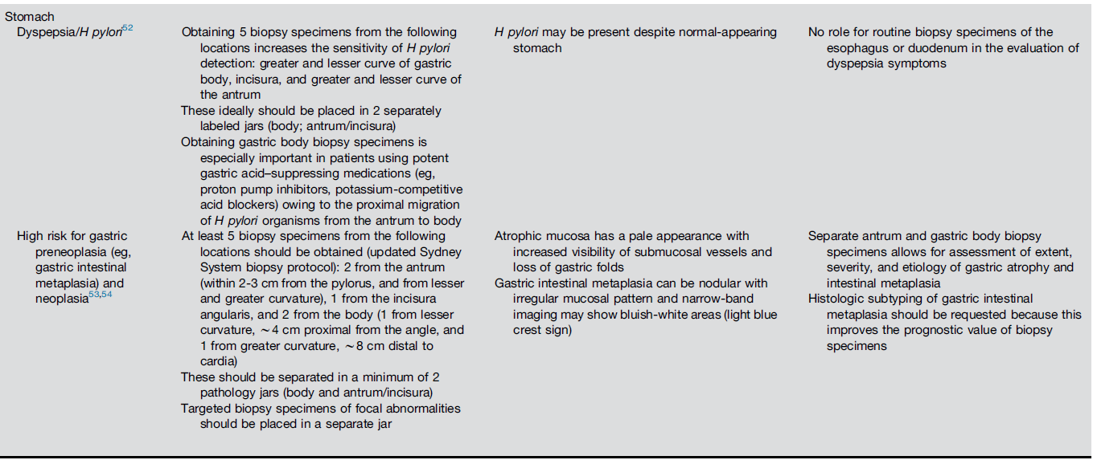
HOW TO DO IT
Biopsy: Sydney protocol
Nagula S et al, Clinical Gastroenterology and Hepatology 2024;22:933–943

Slide 27
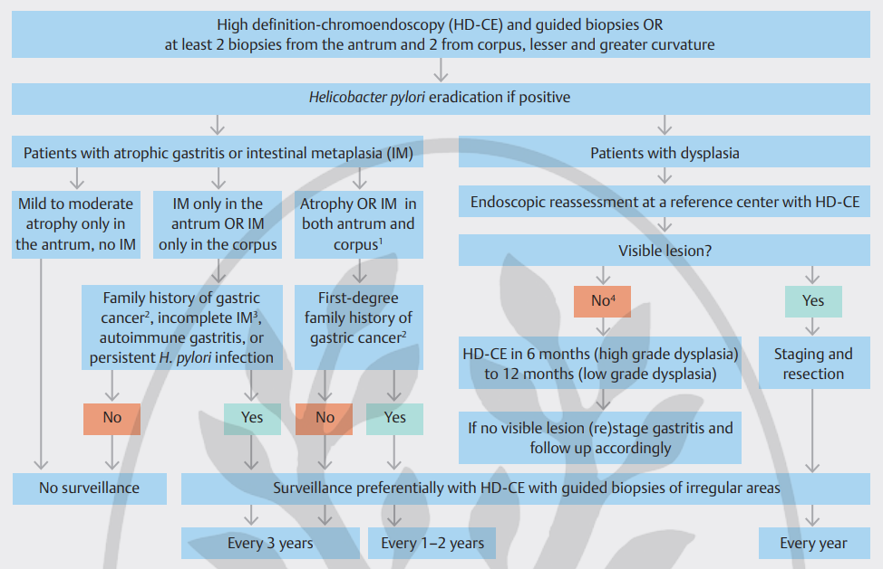
SURVEILLANCE
Pimentel-Nunes Pedro et al. MAPS II … Endoscopy 2019; 51

Slide 28
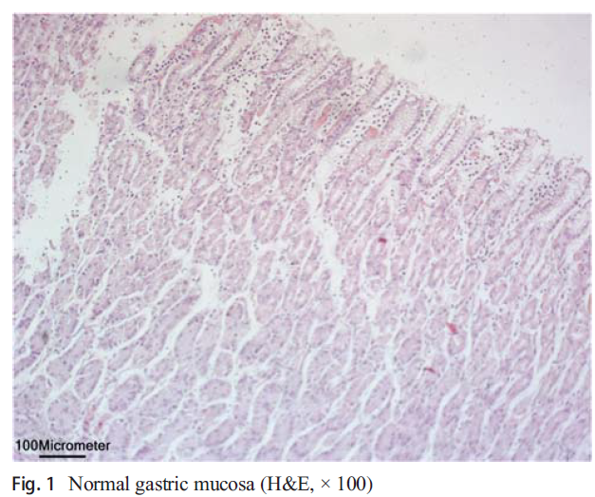
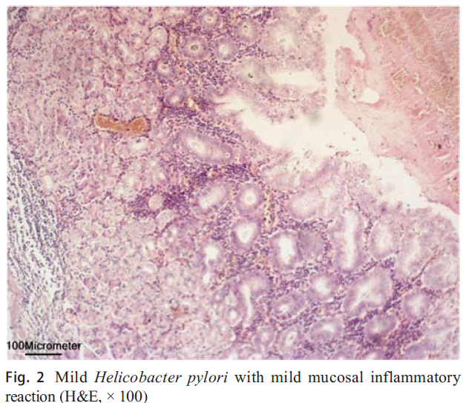
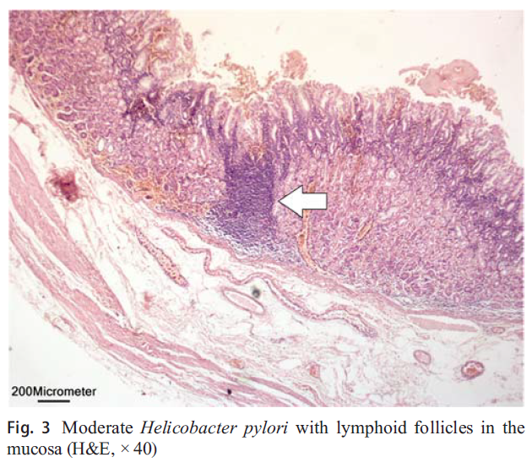
HELICOBACTER PYLORI
Helicobacter pylori infection is present in 23% to 70% of patients scheduled for bariatric surgery.
Emile S et al. Obes Surgery, May 2020

Slide 29
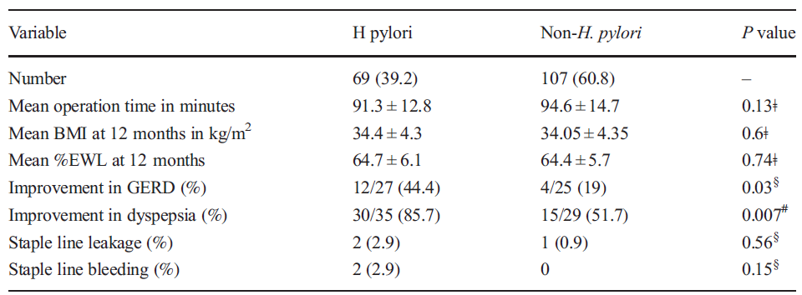
HELICOBACTER PYLORI
176 pazienti obesi trattati con LSG (analisi HP su pezzo operatorio)
69 pz (39.2%) erano positivi all’HP (presentavano più alto BMI, aumentata incidenza di GERD e riferivano dispepsia)
Eradicazione efficace in 67/69 (97.1%) pazienti
Pazienti HP + avevano incidenza di GERD più elevata rispetto al gruppo HP-
Il miglioramento dei sintomi di GERD nei pz HP+ che avevano eradicato l’infezione era maggiore di due volte rispetto a quello ottenuto nel gruppo HP-
Emile S et al. Obes Surgery, May 2020
Notes:
L’infezione da HP è un argomento molto dibattuto

Slide 30
HELICOBACTER PYLORI
Kaplan K et al. Obes Surgery, July 2021

Slide 31
HELICOBACTER PYLORI
Abu Abeid A et al. Obes Surgery, 2022
Notes:
STUDIo che dice che l’HP non altera l’outcome (in corso di presentazione devi dire le conclusioni che ci sono sopra)

Slide 32
HELICOBACTER PYLORI
El Nakeeb A et al. Obes Surgery, 2024
Notes:
STUDIo che dice che l’HP non altera l’outcome (in corso di presentazione devi dire le conclusioni che ci sono sopra)

Slide 33
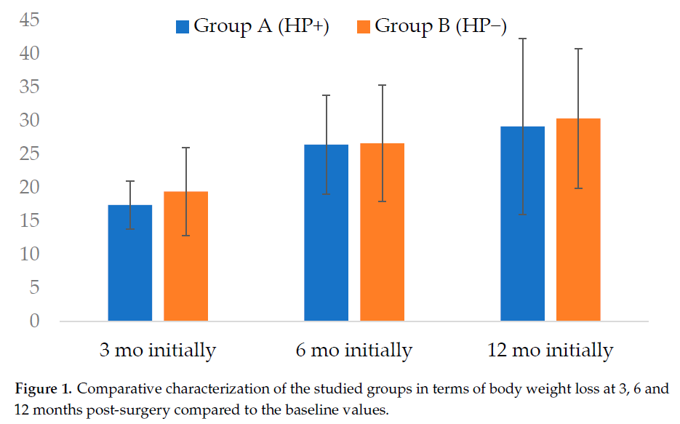
HELICOBACTER PYLORI
Observational cohort study
-93 LSG patients
Conclusions: Patients with active HP infections undergoing SG displayed comparable rates of short- and long-term complications to the non-infected group.
Active HP infection did not impact body weight loss outcomes at 12 months,
Łukasiewicz M et al. J. Clin. Med. 2025
Notes:
STUDIo che dice che l’HP non altera l’outcome (in corso di presentazione devi dire le conclusioni che ci sono sopra)

Slide 34
HELICOBACTER PYLORI
There are conflicting data for preoperative testing and treatment of H pylori with respect to related surgical outcomes and additional studies are needed.
Evans JA et al. American Society for Gastrointestinal Endoscopy Standards of Practice Committee. Gastrointest Endosc. 2015 May

Slide 35
RATIONALE FOR PRE-OPERATIVE EGD
Obesity is a major risk factor for
-GERD (hiatal hernias) and related pathology
-Ulceration
-Cancer
Inability to survey gastric remnant post-operation
Important for clinical decision making
Provide additional information\necessities (hiatal hernia repair)
Provide preoperative treatment (e.g., eradication of Helicobacter pylori).
Poor correlation between symptoms and findings
Notes:
Ma quindi ora che abbiamo visto come si fa una EGDS di qualità e la necessità del campionamento bioptico con l’eventuale necessità di trattare l’HP, vediamo il razionale e a cosa serve effettivamente la EGDS
However, the primary strength of preoperative upper endoscopy lies not in the detection of hiatal hernias, but in its ability to diagnose dysplasias, malignancies, and severe reflux esophagitis, which we consider essential before performing bariatric surgery.
Examination can provide additional information that warrants qualification for bariatric surgery, selection of its type, and necessity of concomitant surgical procedures (e.g., hiatal hernia repair) and preoperative treatment (e.g., eradication of Helicobacter pylori).

Slide 36
BARRIERS TO IMPLEMENTATION
Procedure costs
Access
Controversy over clinical yield

Slide 37
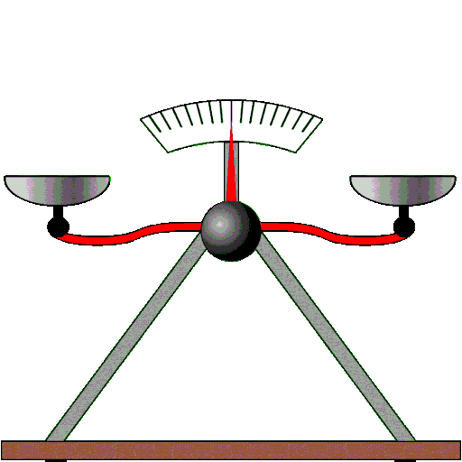
Pre-Operative EGD
Which type of patient?
Reflux
Not Reflux
37
37
Notes:
37
37
Reflussogeno vs non reflussogeno
37

Slide 38
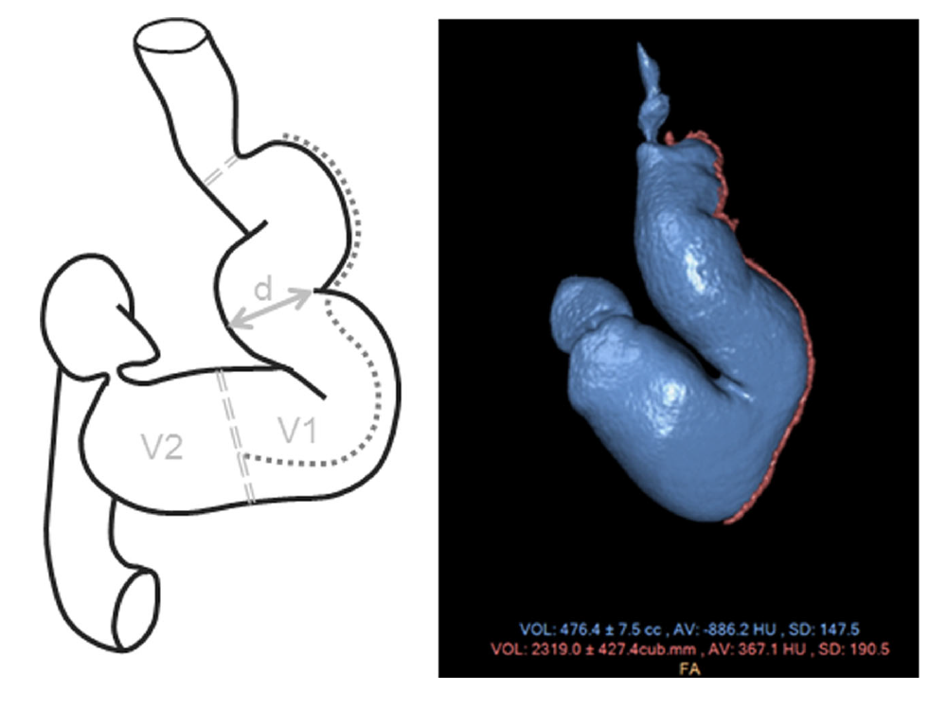
Post-LSG anatomy
Aumentato rischio di GERD post-sleeve
-Perdita normale conformazione dell’angolo di His
- Tubulo che aumenta la pressione intragastrica e riduce la normale compliance gastrica
-Migrazione intra-toracica dello stomaco residuo (sviluppo di ernia iatale)
-Tecnica chirurgica complicata con stenosi\twisting
Mion F et al, Obes Surg 2016
Notes:
The presence of a hiatal hernia and endoscopic signs of reflux esophagitis represent a relative contraindication to SG because of an increased risk of the development of de novo GERD-type symptoms and esophageal mucosa injury after SG.

Slide 39
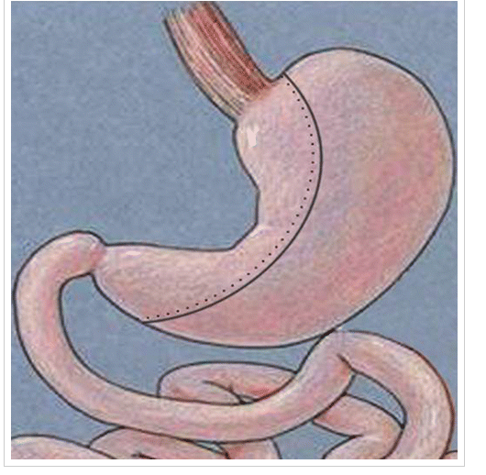
Post-LSG anatomy
Physiopathology:
- Mechanic Theory → High Pressure on the “angle of His“ due to:
1)Excessive acuity of the gastric sleeve’s angle
2)Gastric sleeve’s sub-stenosis
3)Altered piloric motility
Perez M et al, Obesity Surgery 2014

Slide 40
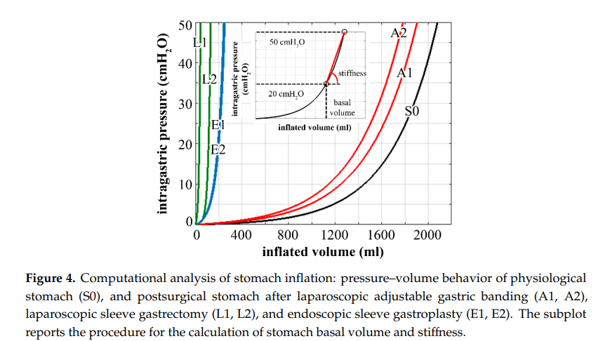
Post-LSG anatomy
Toniolo I et al, Bioengineering Dec 2020
Notes:
. Computational results point out the actual influence of surgical parameters on stomach mechanical functionality concerning stomach capacity and stiffness (Figures 4 and 5) but also mechanical stimulation of gastric receptors (Figures 6 and

Slide 41
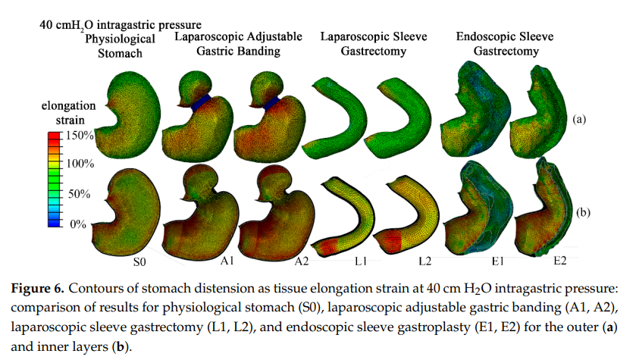
Post-LSG anatomy
Toniolo I et al, Bioengineering Dec 2020

Slide 42
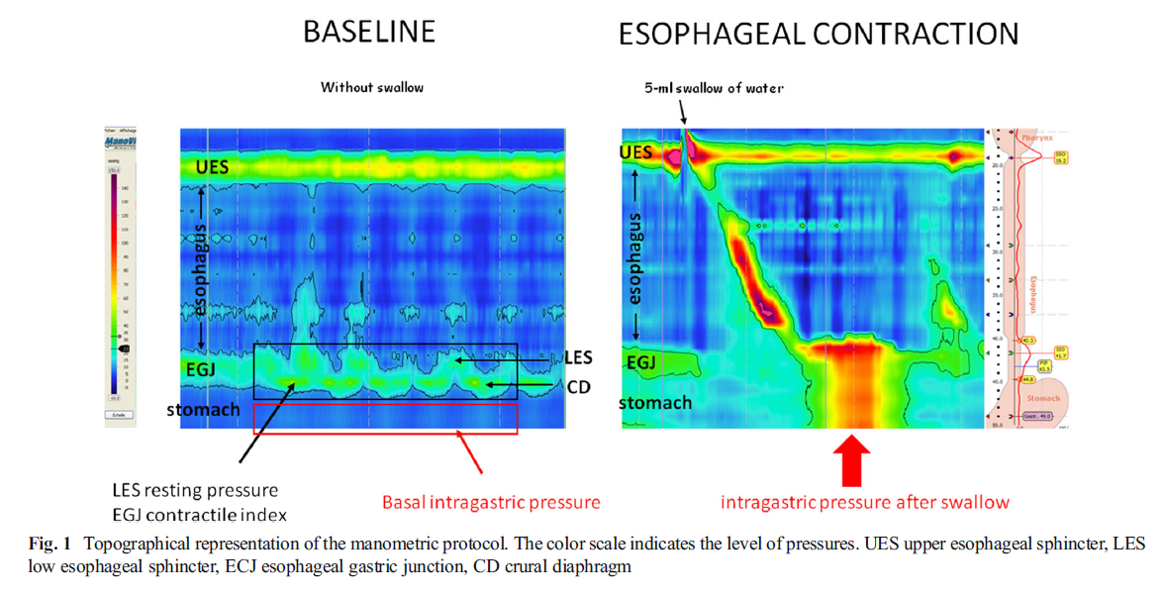
Regular anatomy
Coupaye M et al, Obes Surg 2020

Slide 43
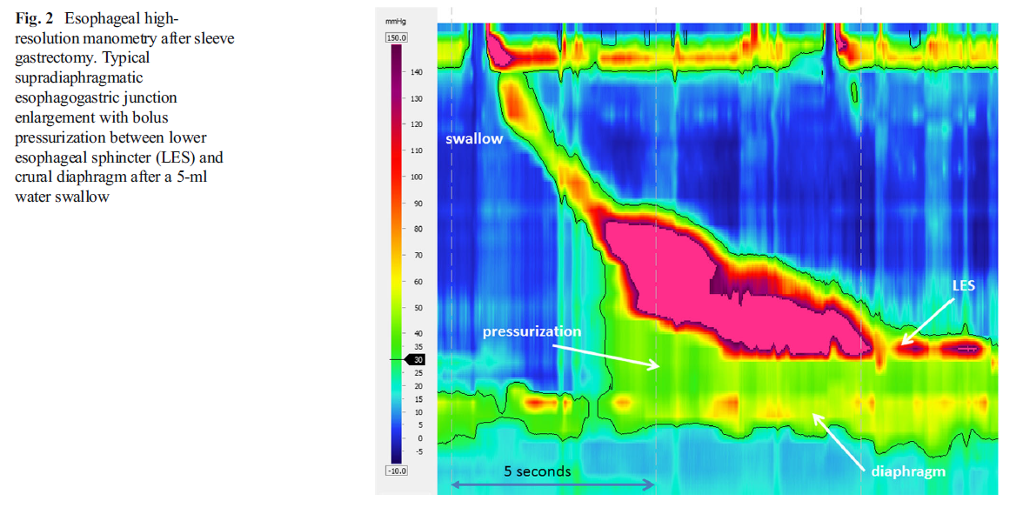
Post-LSG anatomy
Altered manometry
Mion F et al, Obes Surg 2016
Notes:
Manometria alterata post-LSG

Slide 44
Barrett esophagus after LSG
10 studi, 680 pazienti
EGDS di controllo a 6 mesi dall’intervento
11,6% prevalenza stimata di BE (non associata a sintomi GERD)
45% tasso di GERD de novo
13% aumento annuale del rischio di esofagite post SG
Qumseya BJ et al, Gastrointest Endosc. 2021 Feb

Slide 45
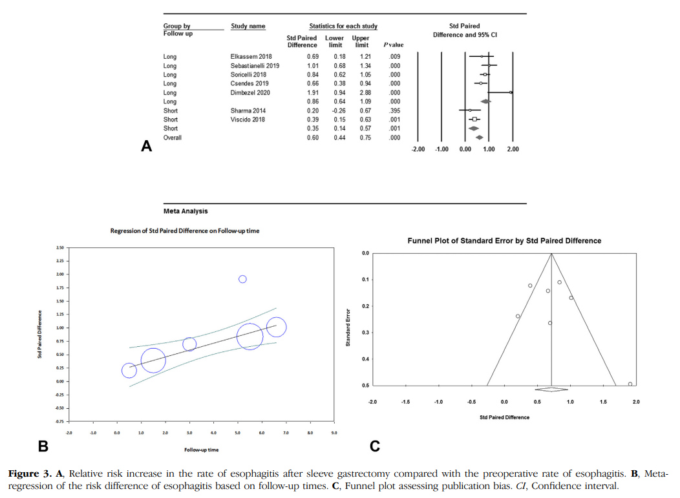
Barrett esophagus after LSG
Qumseya BJ et al, Gastrointest Endosc. 2021 Feb

Slide 46
Post-LSG anatomy
According to the Bariatric Outcomes Longitudinal Database, LRYGB is more effective than other weight loss procedures in reducing GERD symptoms.
5-year outcomes of combined data from two randomized clinical trials (SLEEVEPASS and SM-BOSS) revealed that around 8% of patients undergoing SG necessitated conversion to RYGB due to GERD.
Wolnerhanssen BK et al, Br J Surg 108(1):49–57
Notes:
17. Wolnerhanssen BK, Peterli R, Hurme S, Bueter M, Helmio M,
Juuti A et al (2021) Laparoscopic Roux-en-Y gastric bypass versus
laparoscopic sleeve gastrectomy: 5-year outcomes of merged
data from two randomized clinical trials (SLEEVEPASS and SMBOSS).

Slide 47
Pre-Operative EGD
Thirteen (3.2%) patients had their planned sleeve gastrectomy switched to a laparoscopic gastric bypass procedure (LGBP) because of findings of gastroesophageal reflux disease (GERD)
Conclusion: Based on our study with a large, comprehensive cohort, we conclude that a preoperative EGD is indicated before SG, but it is not necessary before RYGB for asymptomatic patients without any risk factors for gastric pathology (family history of gastric cancer; H. pylori infection; usage of NSAIDs; smoking, age >50 ; chronic kidney ,heart ,or lung disease).
Saarinen T et al. Surg Obes Relat Dis 2018;14:757-62

Slide 48
General (future?) consideration
New-onset GERD was significantly lower in the ESG group compared with the SG group (1.9% vs 14.5%, P <.05).
Fayad L et al, Gastrointestinal Endoscopy. Apr 2019

Slide 49
Pre-Operative EGD
BIG QUESTIONS
Pre-operative upper GI endoscopy modify the subsequent surgery?
Is necessary to all the patients or just to a selected and restricted bariatric population?
49
49
Notes:
49
49
49

Slide 50
Pre-Operative EGD
Patients with symptoms of GERD, such as heartburn, regurgitation, dysphagia, or any postprandial symptoms that suggest a foregut pathology and/or who chronically use antisecretory medications, should have an upper GI endoscopic evaluation before bariatric surgery.
Hampel H et al, Ann Intern Med, 2005
Notes:
Hampel H, Abraham NS, El-Serag HB. Meta-analysis: obesity and the
risk for gastroesophageal reflux disease and its complications. Ann
Intern Med 2005;143:199-211.

Slide 51
Post-LSG anatomy
Age >55 years and the presence of GERD in the history were associated with an abnormal finding on screening upper endoscopy.
Salama A et al, Obes Surg 2018;28:52-60
Notes:
9. Salama A, Saafan T, El Ansari W, et al. Is Routine Preoperative Esophagogastroduodenoscopy Screening Necessary Prior to Laparoscopic Sleeve Gastrectomy? Review of 1555 Cases and Comparison with Current Literature. Obes Surg 2018;28:52-60

Slide 52
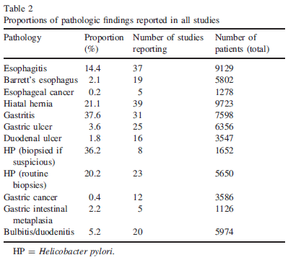
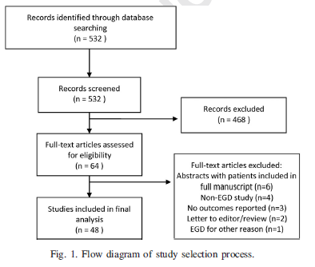
Pre-Operative EGD
Metanalisi
12,261 patients
Conclusion: it is reported a very low incidence of findings that can change the surgical managment.
It is not recomended a routine endoscopy. Cost-Benefit
S. Bennett et al. / Surgery for Obesity and Related Diseases, 2016.

Slide 53
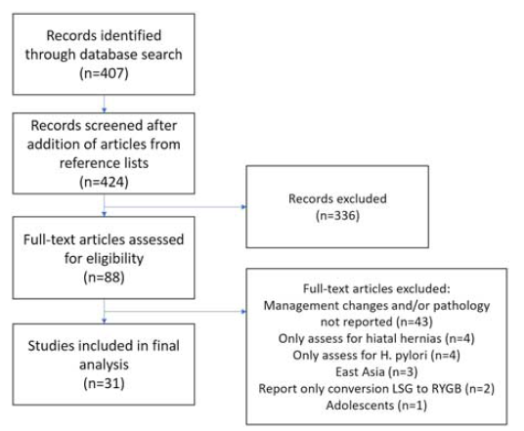
Pre-Operative EGD
Meta-analysis: COST ANALISYS
13,867 endoscopies
Conclusion: because the high cost, the benefit of routine pre-operative endoscopy must be individualized
Evans G et al. J Clin Gastroenterol - May/June 2020

Slide 54
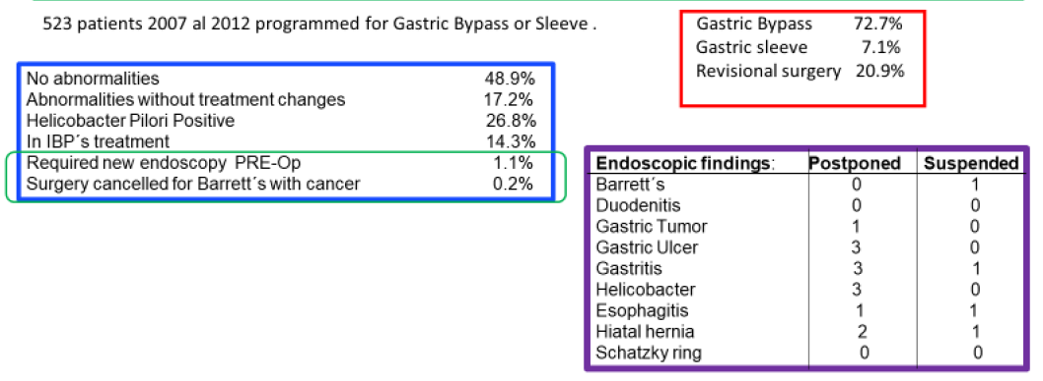
Pre-Operative EGD
Conclusion: It is not justified to perform routine preoperative endoscopy in bariatric patients
There is a high number of patients that are programmed to surgery
The Cost-benefit is not justified
Schigt A et al. Surgery for Obesity and Related Diseases, May/June 2014

Slide 55
Pre-Operative EGD
Mazahreh T et al. Clinical and Experimental Gastroenterology 2019:12
Notes:
After one year, all individuals were assessed for the presence of symptomatic GERD and no significant difference was found between the two groups.

Slide 56
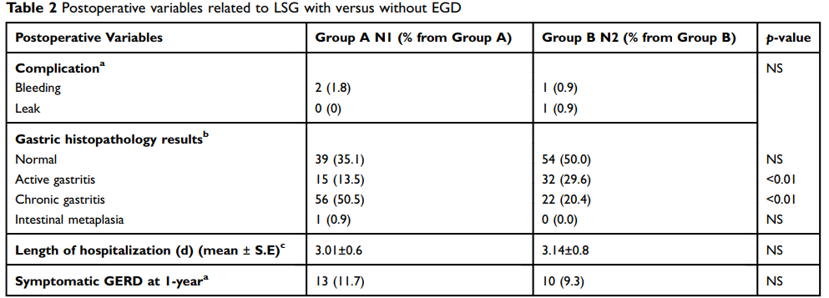
Pre-Operative EGD
Conclusion: It is not mandatory to perform a pre-operative endoscopy in asymptomatic reflux previous to a sleeve gastrectomy. There is no difference of post-operative problems in both groups.
Mazahreh T et al. Clinical and Experimental Gastroenterology 2019:12
Notes:
After one year, all individuals were assessed for the presence of symptomatic GERD and no significant difference was found between the two groups.

Slide 57
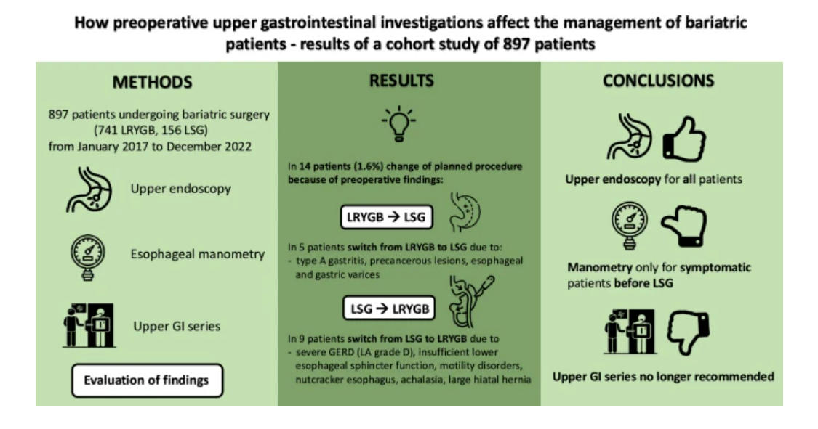
Pre-Operative EGD
Poljo A et al, Surgical Endoscopy, Jan 2025
Notes:
However, it seems reasonable to extend the necessity of manometry in any patient with symptoms suggestive of severe motility disorder before any bariatric procedure
[26].

Slide 58
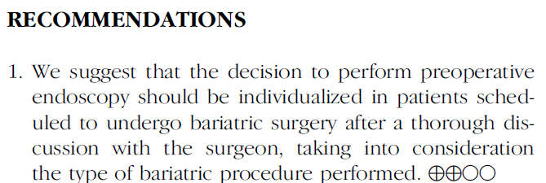
GUIDELINES
Evans JA et al. ASGE STANDARDS OF PRACTICE COMMITTEE - Surg Endosc (2015) 29:1007–1017

Slide 59
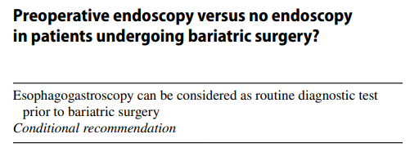
GUIDELINES
Di Lorenzo N et al, EAES guidelines, Surg Endosc. 2020 Jun

Slide 60
GUIDELINES
Sicob, 2023

Slide 61
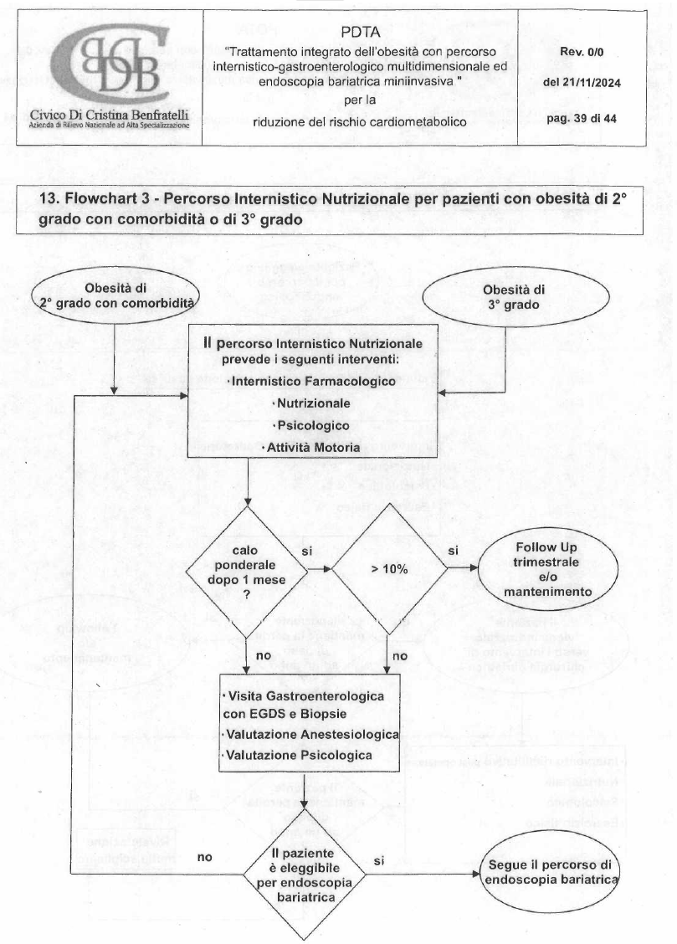
PDTA AZIENDALE
Notes:
Non so se vogliamo metterlo o no

Slide 62
CONCLUSION
An endoscopic work-up should be strongly recommended in all bariatric patients.
Quality endoscopy must be performed according to certain behavioral, biopsy and classification criteria.
Pre-operative EGD frequently identifies significant GI pathology and prompts important treatments (cost-benefit?).
A multidisciplinary approach should be supportive in designating the best surgical option for the patient and subsequent follow-up.
Notes:
L’endoscopia di qualità deve essere eseguita secondo determinati criteri comportamentali, bioptici e classificativi
Un approccio multidisciplinare dovrebbe essere di supporto per designare la migliore opzione chirurgica per il paziente e il successive follow-up

Slide 63
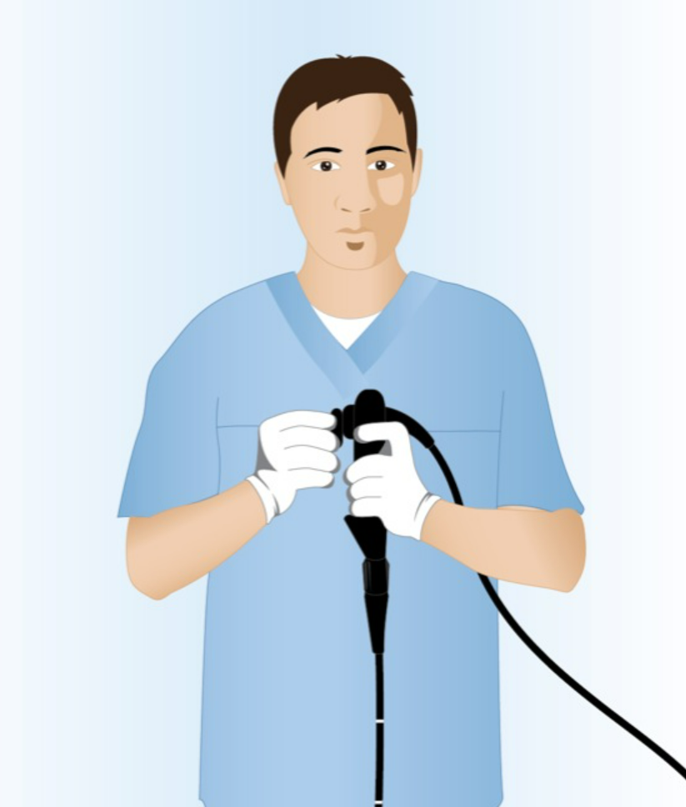
CONCLUSION
CLOSE COLLABORATION
Notes:
IMPORTANTE: Si potrebbe dire anche che se il paziente parte con l’indicazione a LSG già dall’inizio, non ha intenzione di fare intervento diverso o escludente, e avendo un istologico in corso di intervento in quanto viene asportato il pezzo operatorio (sleeve gastrectomy), si potrebbe anche pensare di non fare la EGDS pre-operativa a maggior ragione se il paziente non ha sintomi di rilievo. Quindi collaborazione chirurgo endoscopista è fondamentale in tal senso.
Anche perché come sappiamo fare la gastroscopia a tutti non è proprio semplice, c’è un bel carico
EGDS quando è effettivamente giusta farla? Quando viene deciso di fare un intervento diverso dalla sleeve (quindi un intervento in cui il pezzo chirurgico non lo abbiamo ma bensì escludiamo stomaco) oppure quando Paziente oppure in valutazione per il tipo di intervento chirurgico

Slide 64
Grazie

